Slide 1
Lifestyle Changes More Effective at Preventing Chronic Disease
Rachel Khoo
Thinkful Capstone 3
October 2020

Slide 2
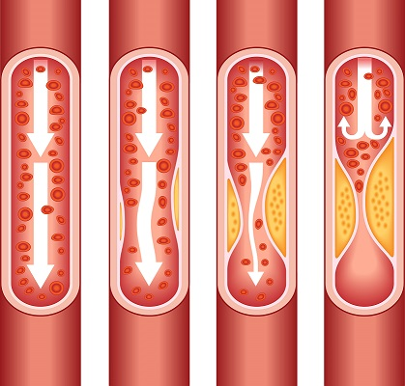
Many chronic disease can be prevented
Heart disease is the highest killer in the US
Cholesterol screenings
Blood pressure medications
Physical Activity
Notes:
About two-thirds get chol screen
Only about 50% of people who would benefit from bp meds are on them
50% of Americans don’t get enough exercise

Slide 3
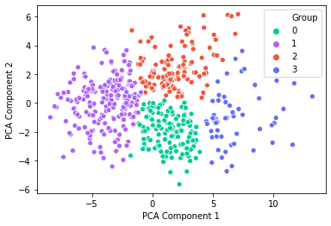
Who needs to be targeted for prevention?
Kmeans clusters health data into four groups
Health Outcomes
Prevention Measures
Behavioral Risk Factors
Notes:
Data is from the 500 cities project from the CDC

Slide 4
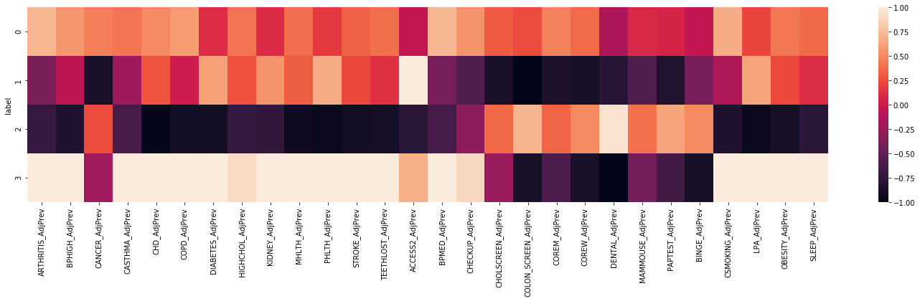
Who needs to be targeted for prevention?
Heath Outcomes
Prevention Measures
Habits

Slide 5
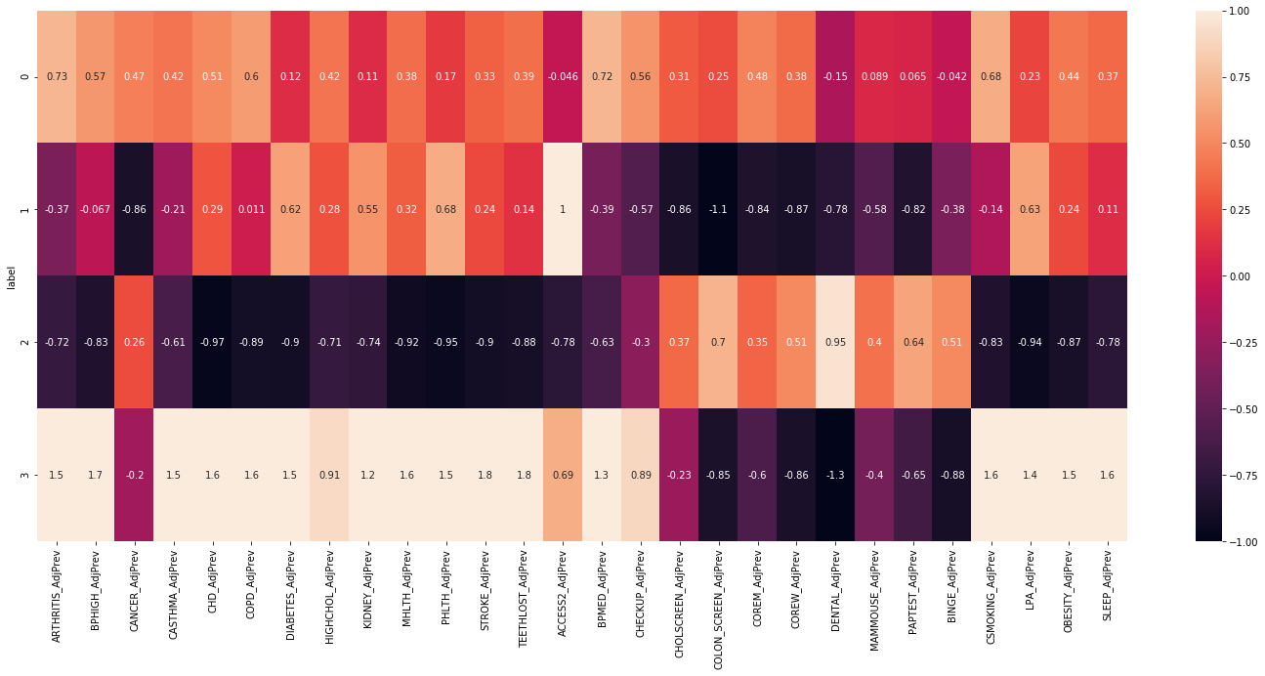
Group 0 – Bad habits cancel out prevention
Heath Outcomes
Prevention Measures
Habits

Slide 6
Group 1 – No prevention and bad habits
Heath Outcomes
Prevention Measures
Habits

Slide 7
Group 2 – Prevention without bad habits
Heath Outcomes
Prevention Measures
Habits

Slide 8
Group 3 – Bad habits dominate
Heath Outcomes
Prevention Measures
Habits

Slide 9

Many cities in California skew this bar

Slide 10


Slide 11

Prevention overshadowed by habits
Mainly eastern states

Slide 12

No prevention and bad habits
Generally southwest

Slide 13

Prevention without bad habits
Mostly in large cities

Slide 14

Bad habits dominate
Mainly east and south

Slide 15
Prevention isn’t the most effective strategy
Lack of access to healthcare
Poor lifestyle choices

Slide 16
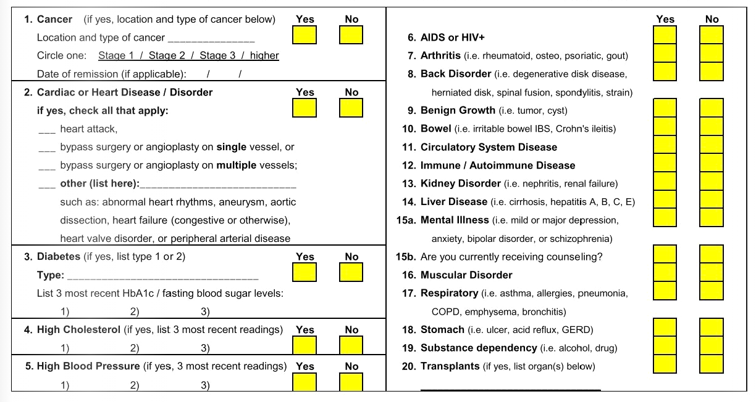
How do we lower rates of heart disease?
Focus on lifestyle changes
Medications and screenings
Incorporate into insurance

Slide 17
Further research could refine these groups
Gender information
Age ranges
More cities surveyed

